Slide 1
Species Reports
Make a video
Have fun!
Use reputable sources to get your information
See the canvas site for the full assignment and an example

Slide 2
Class Crustacea: Senses, Development and more Taxonomy
A big day in 310

Slide 3
Crustacean Senses
Mechanoreception
Touch, “hearing,” proprioception
Proprioception: different from other senses because it provides internal feedback – i.e. limb position, movement, cuticular stress
Chemoreception
Photoreception
Notes:
Proprioception: cuticular stress detectors. Elastic strands connected to cuticle in limbs. Stress to the cuticle (such as movement) will signal the rest of limbs – probably important when trying to coordinate 19 pairs of appendages ☺

Slide 4
Crustacean Sense Organs
Eyes (photoreception)
Sensory Setae (Mechanoreception and Chemoreception)
Statocysts (balance)

Slide 5
Crustacean Eyes
Most have two compound eyes
Compound eye
Independent photoreception unit containing cornea, lens, and cells to distinguish brightness and color
Ommatidia: single visual unit of compound eye
Naupliar Eye
Does not form images
Determines direction of light source

Slide 6
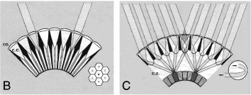
Types of Compound Eyes
Apposition Eye
Each lens is directly apposed to the rhabdom (photo receptor, light sensing).
Each lens is very small; each rhabdom receives very little light
Works best in bright light
Superposition Eye
Numerous ommatidia combine to direct their light onto a single rhabdom
Animals can see better in dim light
Notes:
Apposition = B, superposition = C

Slide 7
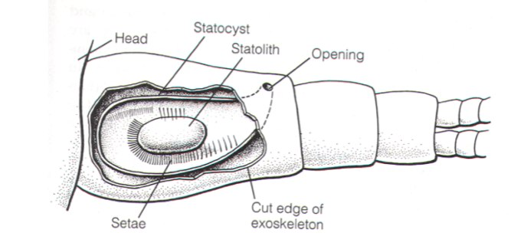
Statocysts
The equilibrium receptor (balance)
Cavity with heavy particle, statolith rests on setae that detect displacement

Slide 8
Setae
Hair like structures used for mechano and chemo reception (and other)
Extend through exoskeleton—linked to the nervous system
Aesthetascs:
Patches of sensory setae usually found on first antennae
Important for locating food and mates

Slide 9
Senses: in lab
We’ll examine chemoreception by counting antennal flicks before and after adding a food smell to the water
We’ll look at setae: both sensory and other
We’ll look at crustacean eyes

Slide 10
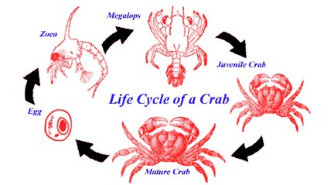
Crustacean Development
Very complicated
Number and type of larval stages varies considerably
Crustacean larvae may look nothing like their parents
Notes:
Barnacles have cyprids, copepods have copepodite
, crabs have zoea and megalops

Slide 11
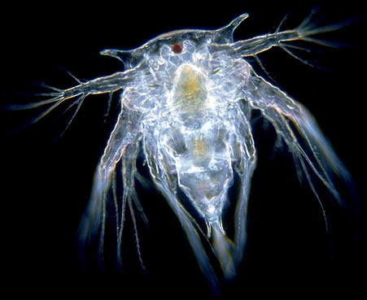
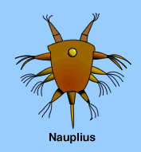
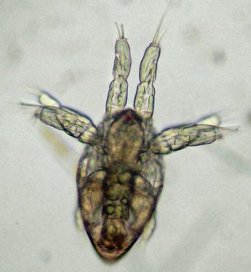
The Nauplius Larva
Characteristic crustacean larval stage: nauplius
The first crustacean larval form
Many pass through this stage in the egg
Has a head and a telson; the thorax and abdomen have not developed yet
One eye
Starts with three appendages but may add appendages after molting
www.mesa.edu
Copepod :www.theseashore.org
Barnacle :www.microscopy-uk.org

Slide 12
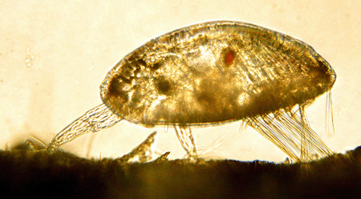
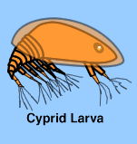
Barnacle Development
Barnacles are highly modified as adults, but the nauplii remain the same
Barnacles spend weeks as a nauplius, undergo 4-6 nauplear molts before molting into a cyprid
Cyprid larva is the final, non-feeding stage before settlement
Cyprid use modified antennae to explore the benthos looking for an appropriate place to settle and metamorphose into an adult
www.mesa.edu
Notes:
Looking for: rough surfaces (tactile) and members of their own species (chemosensory)

Slide 13
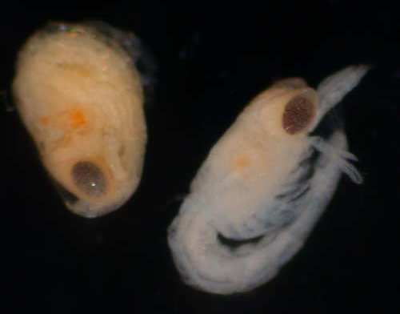
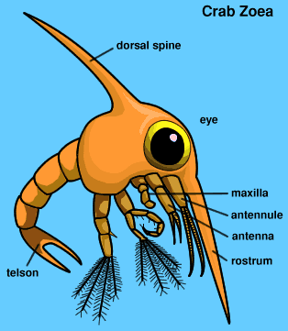
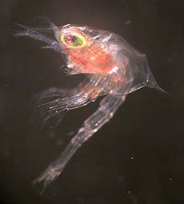
Decapod Development
Decapods usually hatch as a prezoea
Not a true larval stage—a compact form still partially enclosed by the egg membrane
Once membrane is shed (few minutes) the larva is called a zoea.
The zoea’s spines expand and harden—making it more difficult for predators to swallow!
www.mesa.edu
Blue king crab zoea: wikipedia

Slide 14
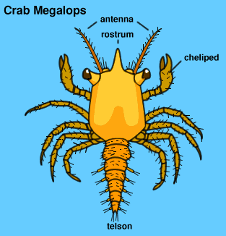
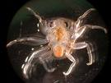
Decapod Development
www.mesa.edu
After weeks or months and several molts as a zoea, decapod larvae molt to the megalops stage
Megalops can both swim and crawl— ideally suited for its sole function of finding good habitat before it settles and becomes a juvenile
www.oceanexplorer.noaa.gov

Slide 15
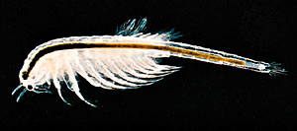
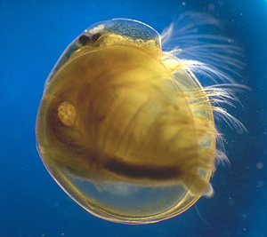
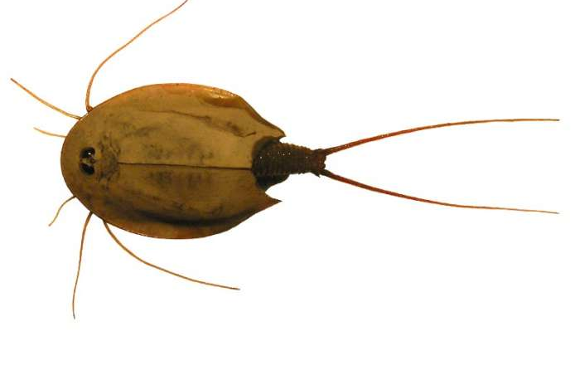
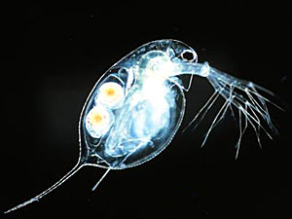
Taxonomy: Subclass Branchiopoda
Many adapted to ephemeral (temporary ponds) or extreme (hypersaline) environments—Maybe because unable to compete or avoid predation in more typical habitat
Many produce cysts that survive long periods of dessication (sea monkeys—add water, hatch instantly)
Characterized by paddle like thoracic appendages that are used for both locomotioin and gas exchange
Composed of 4 orders
Anostroca
Notostraca
Cladocera
Conchostraca
Notes:
Anostraca (brine shrimp), Notostraca (tadpole shrimp or shield shrimp-ephemeral environ ), Cladocera (water fleas, Daphnia-freshwater), Conchostraca (clam shrimp-temp freshwater ponds)

Slide 16
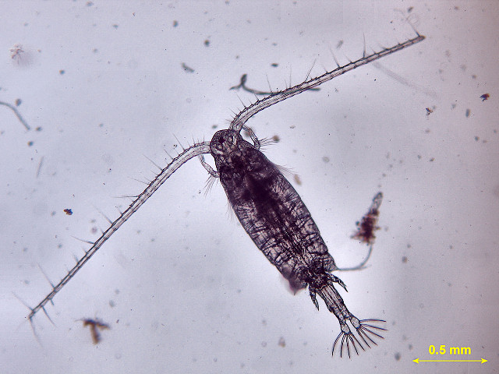
Taxonomy: Subclass Copepoda
Found in fresh, brackish, and marine environments
Found in all marine environments from the surface to depths of over 5000m
Often dominate the marine zooplankton and have incredible ecological importance
May be free living or parasitic. Most free living in one of three orders:
Calanoida
Harpacticoida
Cyclopoida

Slide 17
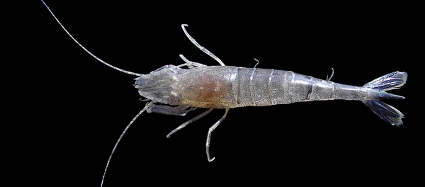
Taxonomy: Shrimp and Shrimpy Taxa
The term shrimp has been used for any crustacean that doesn’t look like a crab, lobster or barnacle (i.e. brine shrimp)
You will learn to identify true shrimp (Caridea) from all other “shrimp”
You will look at coloration, feeding and behavior in a Crangon—a true shrimp

Slide 18
What we are doing today:
We’re looking at lots of different organisms, mostly under the scopes
Have fun and ask lots of questions!!
What not to do:
mix fresh and saltwater samples together
mix live and preserved dishes or pipettes

